Slide 1

Chor Sipahi (Gaming Application)
Presented by
SAND Group (G13) At
KIET GROUP OF INSTITUTIONS
Mentor:
Dr. Vipin Kumar
(Associate Professor, MCA )
Team Members:
Abhishek Kumar Yadav
Niranjan Darshan
Divyansh Pandey
Saurabh Vishwakarma

Slide 2


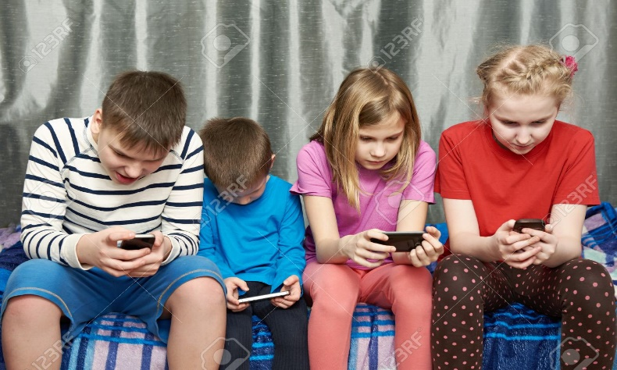
Objective
Non Virtual World:
Virtual World
Moving Toward
Leaving Behind Our
Tradition

Slide 3

Modules of game
Offline Mode:
Players Name List
Playing surface
Online Mode:
Create Room
Join Room (Working on it)

Slide 4
Socio friendly game
The game enhances face reading skill and helps develop cognitive thinking by requiring deductive reasoning. (Who is nervous and who is happy).
This entertaining game can be learned quickly and is a tool to make new friends.
It also let children to know the role of different character used in this game.
We promote primitive culture also from this game.
This game sharpen the child’s memory and improve concentration power.

Slide 5
Implementation
Developing an application which can be accessed by many of the android users. The program will run on about 95%-98% of the Android users.
It is developed in API level 14 and above with the version named as Jelly Beans.
Only 14.52 Mb of internal memory will be used by Applications.

Slide 6
Lets Run Through the Applications

Slide 7
Thank You!!

